Slide 1
Cleaning Window
Final Project Presentation
Liusu Zeng, Wenquan Xing, Ang Li, Junhao Li

Slide 2
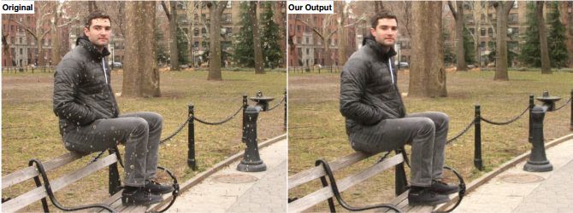
Problem Background
Raindrops reduce photo quality
Our goals: Eliminate raindrop

Slide 3
Initial Attempts
Experimented with basic transforms:
Median filter
Low-pass filter
Edge detection

Slide 4
Our Method
Three steps:
Rain detection—— Hough Transform
Structure and Texture isolation——PDE (ATV)
Restoration——Patch Matching

Slide 5



Our Method
Hough Transform (Circles)
Using parameter equation to present circle
Voting, majority rule
Detection
$$\left(ρcosθ+x_{0},ρsinθ+y_{0}\right)$$
$$ρ$$
$$θ$$

Slide 6


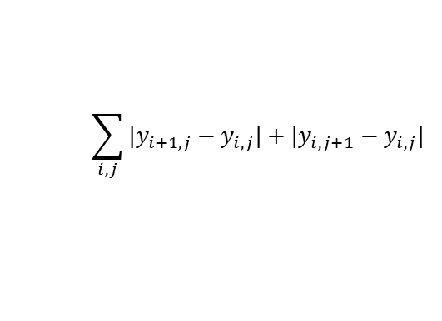
Our Method
PDE isolation (Anisotropic Total Variation)
decompose image into a structural image and a texture image
anisotropic total variance:
$$\sum_{i,j}{|y_{i+1,j}−y_{i,j}|+|y_{i,j+1}−y_{i,j}|}$$

Slide 7
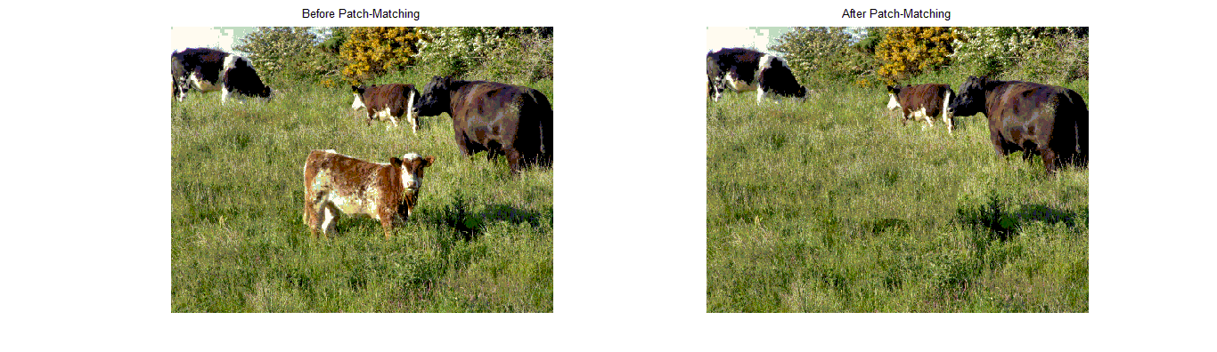
Our Method
Patch Matching
Compare region with its neighbor patch
Replace the region with the most similar patch

Slide 8
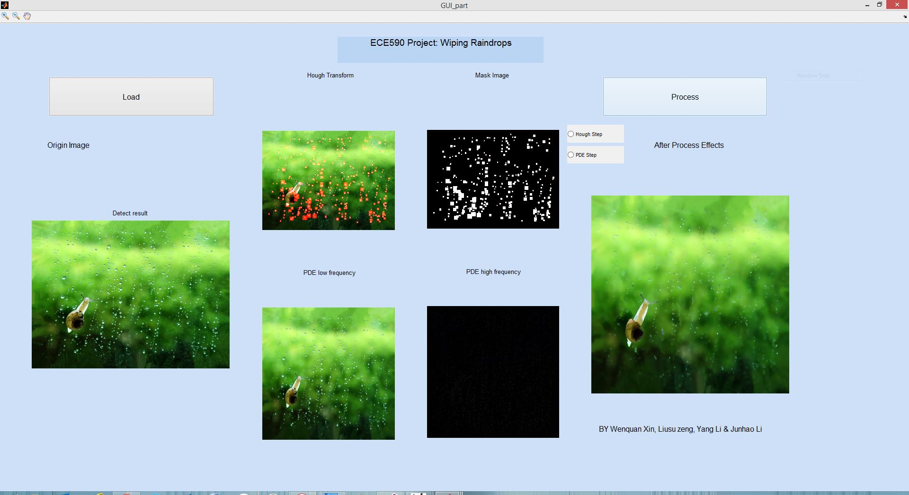
Results

Slide 9
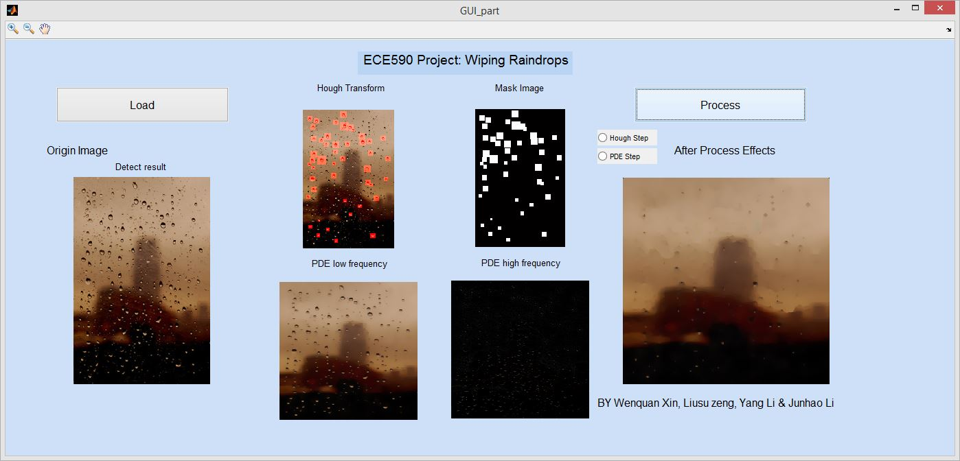
Results

Slide 10
Possible Extensions
Try to eliminate rain drops in very large and small size
Improve patch matching method
Improve algorithm efficiency

Slide 11
Thank you.

